Slide 1
Metagenome Assembly
With MetaValvet

Slide 2
The problem
Assemble metagenomes from a mixed sequence of reads of multiple species.
The methods of metagenome assembly are very limited, and single genome assemblers are often used for metagenome assembly. However, single-genome assemblers are not designed to assemble multiple genomes.

Slide 3
MetaValvet
Implements functions from a single-genome assembly algorithm ‘Valvet’ and adds on to its assembly pipleline to resolve the metagenome problem.

Slide 4
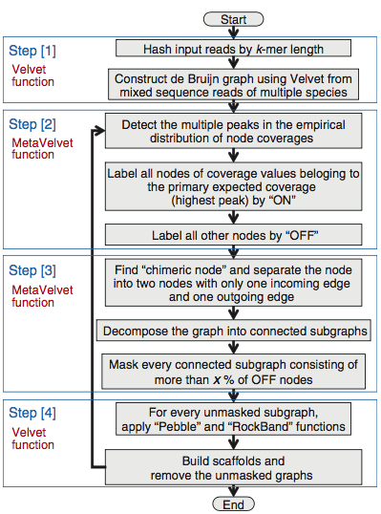
MetaValvet pipeline
Construct a de Bruijn graph from the input reads.
Detect peaks in the on the k-mer frequency distribution.
Decompose de Bruiin graph into sub-graphs.
Assemble contigs and scaffolds.

Slide 5
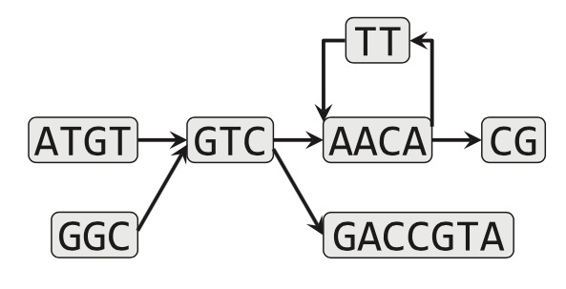
Step 1
MetaValvet uses Valvet functions to hash the mixed sequence reads of the multiple species by k-mer length. It then creates a de Bruijn graph of the hashed k-mers.

Slide 6
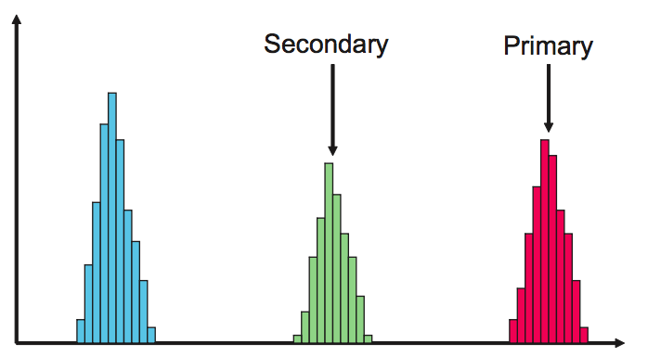
Step 2
MetaValvet calculates the histogram of the k-mer frequencies and finds the different peaks on the histogram. Each of the peaks on the histogram corresponds to the genome of one specie. MetaValvet then approximates the empirical distributions by a mixture of Poisson distributions and assigns each node in the de Bruijn graph to one of the Poisson distribution.

Slide 7
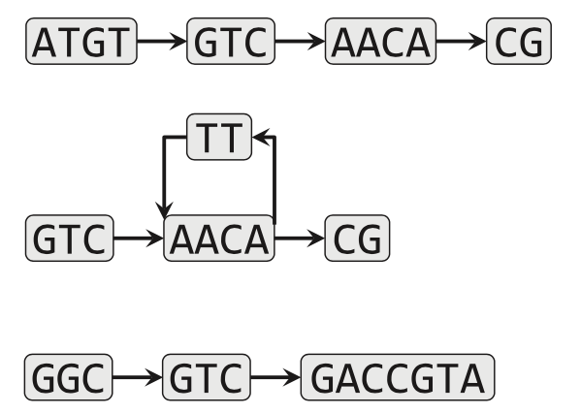
Step 3 & 4
MetaValvet distinguishes subgraphs belonging to the same peak and separates them from the other subgraphs.
MetaValvet then uses the Valvet functions to construct contigs and scaffolds from the decomposed graphs.

Slide 8
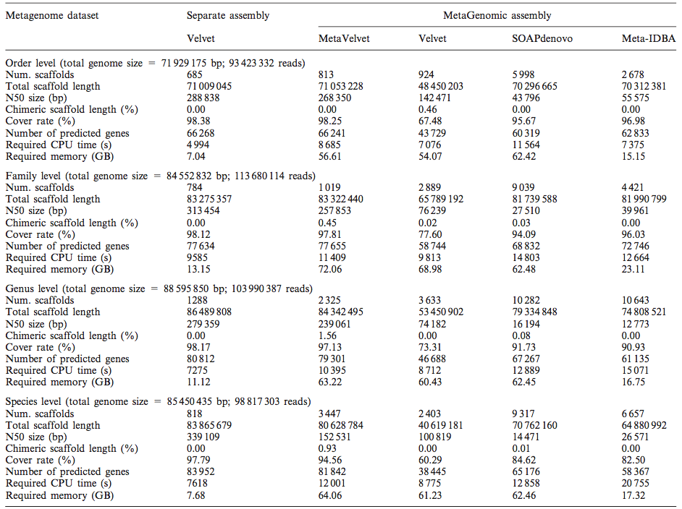
Results – Experimental Datasets
MetaValvet was able to beat the single-genome assembler, Valvet, as well as the metagenome assemblers, SOAPdenovo and Meta-IDBA, in almost all the categories. However, it does seem to require more memory than the other assembly algorithms.

Slide 9
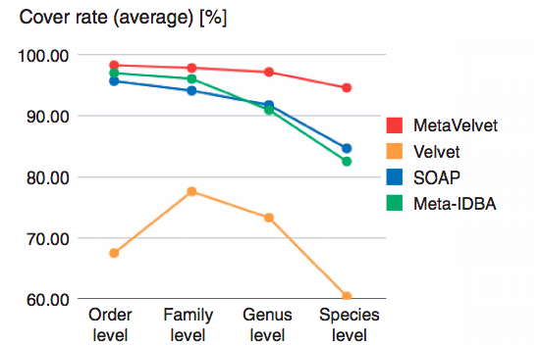
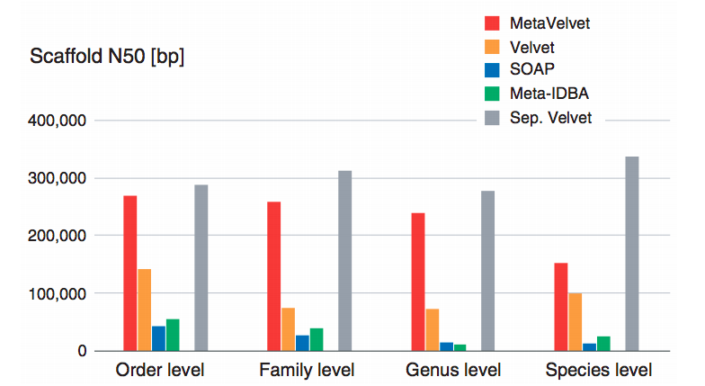
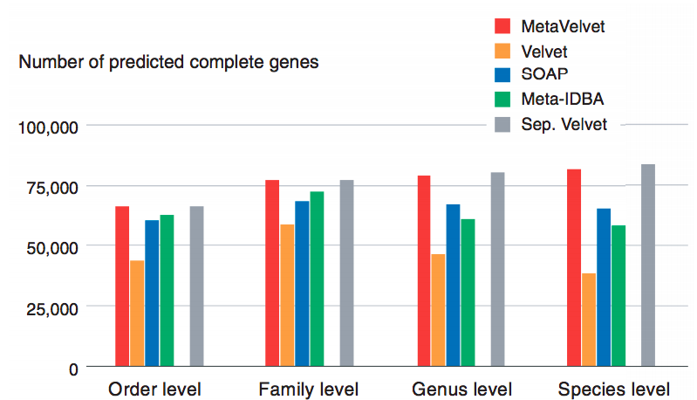
Results – Experimental Datasets (con’d)

Slide 10
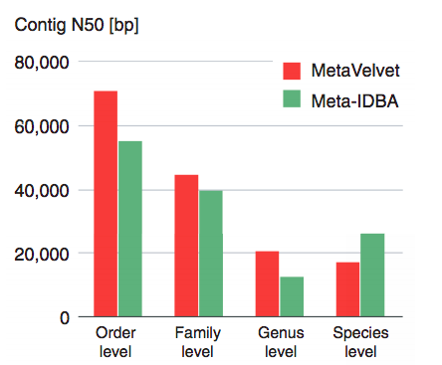
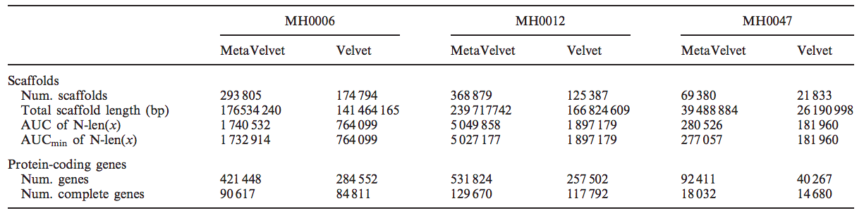
Results – Real Datasets
MetaValvet was also run on real datasets as a part of the project MetaHIT. The results shown on the side are from running MetaValvet on three different datasets of human gut microbial data. MetaValvet was able to output better numbers when compared to Valvet numbers.

